Slide 1
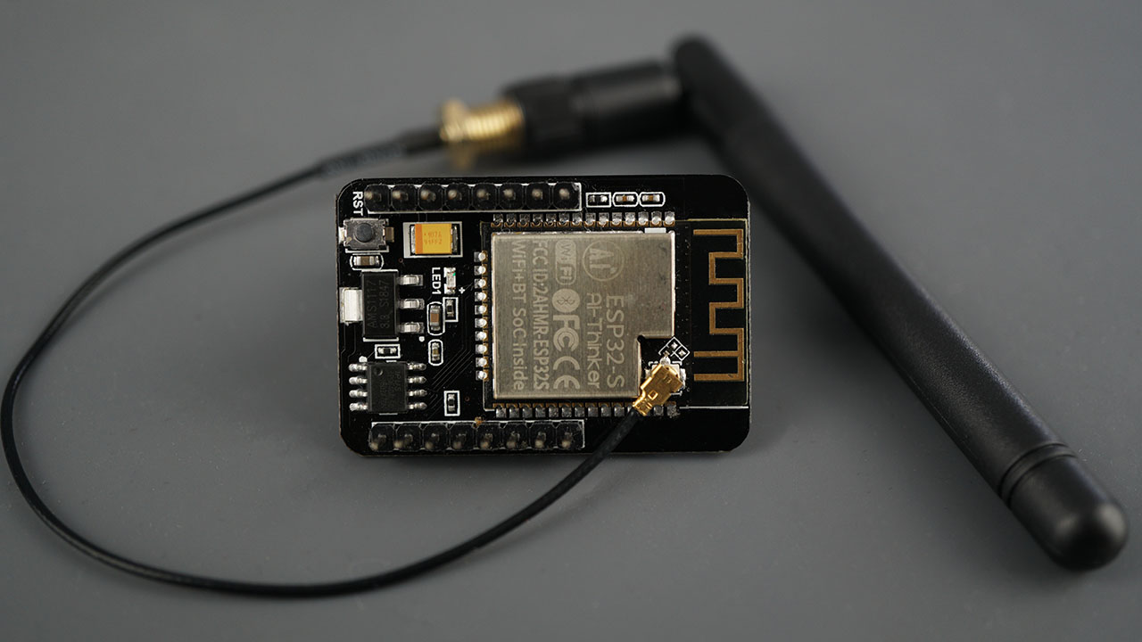

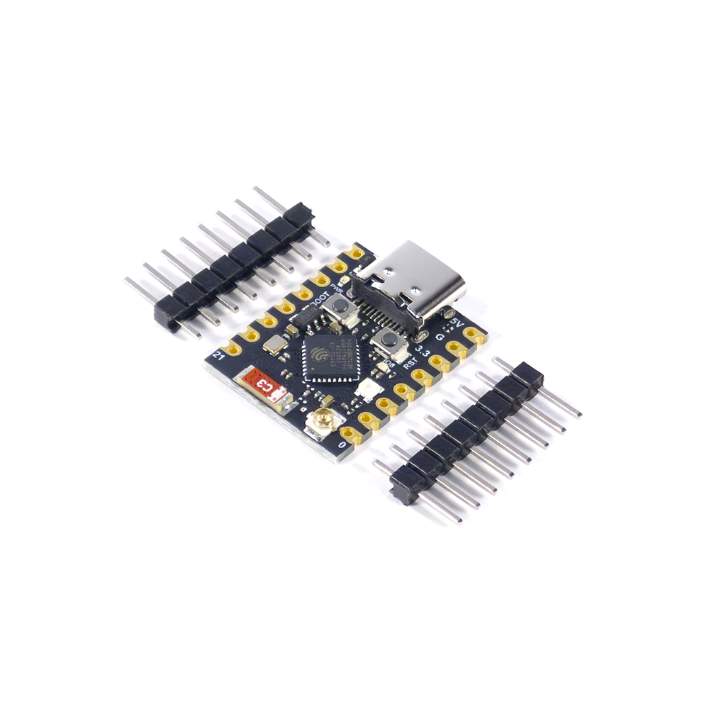

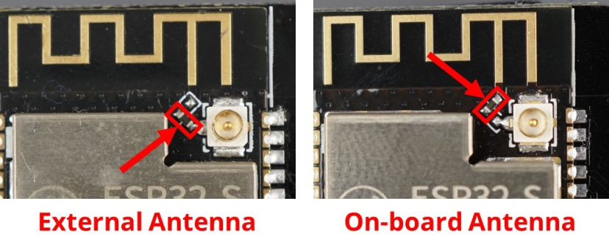
ESP32 WiFi
ESP32 modules provide built-in Wi-Fi connectivity, enabling devices to communicate over networks, act as access points, or form mesh networks for IoT applications.
Instructor: Dr. A. Pormand
by Mohamad mahdi Latifi
1

Slide 2
├── F ESP NOW/
│ ├── Intro to ESP NOW
│ └── Use Cases
│
├── G ESP Mesh/
│ ├── Intro to ESP Mesh
│ └── Routing Basics
│
└── I Security/
└── WPA2 and Handshake
ESP32 WiFi/
├── A Basics/
│ ├── What is ESP32
│ ├── What is WiFi
│ └── ESP32 WiFi Hardware
│
├── B WiFi Modes/
│ ├── Station Mode
│ ├── Access Point Mode
│ ├── Dual Mode AP+STA
│ └── Promiscuous Mode
│
├── C Networking/
│ ├── TCP IP
│ ├── UDP
│ ├── Sockets
│ └── WebServers
│
└── D WiFi Stack Internals/
├── WiFi Protocol Stack
├── Peripheral Buffers
└── MTU
├── J Cloud/
│ ├── MQTT
│ ├── HTTP REST
│ └── OTA Updates
│
├── K Cool Projects/
│ ├── WiFi Repeater
│ ├── ESP Mesh Project
│ ├── ESP NOW LongRange
│ ├── WiFi Sniffer
│ ├── WiFi Heatmap
│ ├── WebRadio
│ └── ESP32 CAM Streaming
2

Slide 3
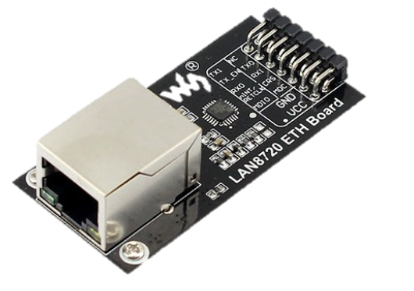
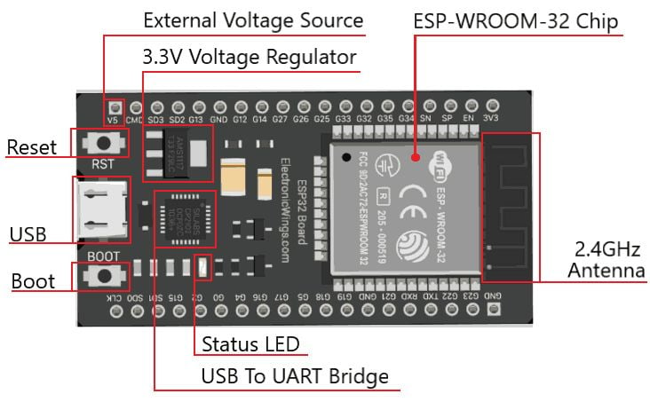
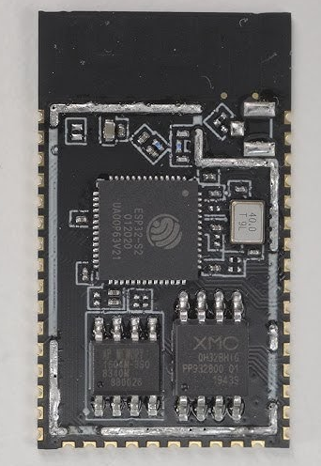
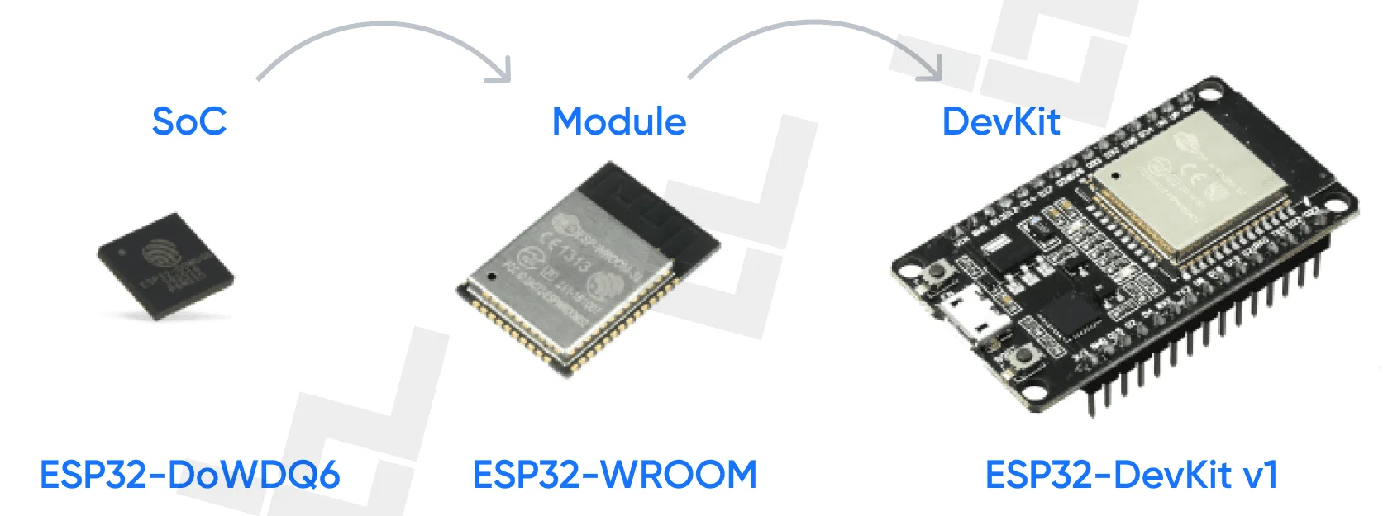
3
What is ESP32
What is ESP32
External PHY
LAN8720 ETH Board
The ESP32 is a powerful, low-cost microcontroller with built-in Wi-Fi and Bluetooth.
ESP32-S2

Slide 4
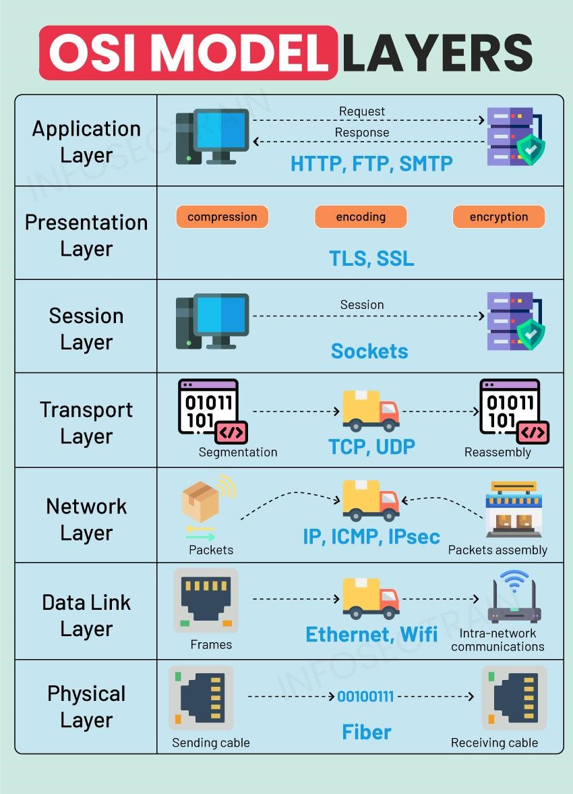
4
Network Layers
Network Layers
Network layers are a way to organize communication functions in a network. Each layer has a specific role, like sending data, routing, or error checking, to make devices communicate efficiently.
The OSI (Open Systems Interconnection) Model (The 7-Layer Network Stack)
Physical Layer – The actual signals (radio waves, cables, voltage).
Data Link Layer – Local network communication (MAC addresses, frames).
Network Layer – Routing between networks (IP addresses).
Transport Layer – Reliable connection & data delivery (TCP/UDP).
Session Layer – Manages sessions between devices.
Presentation Layer – Data formatting, encoding, encryption.
Application Layer – What applications use (HTTP, MQTT, browsers, apps).

Slide 5
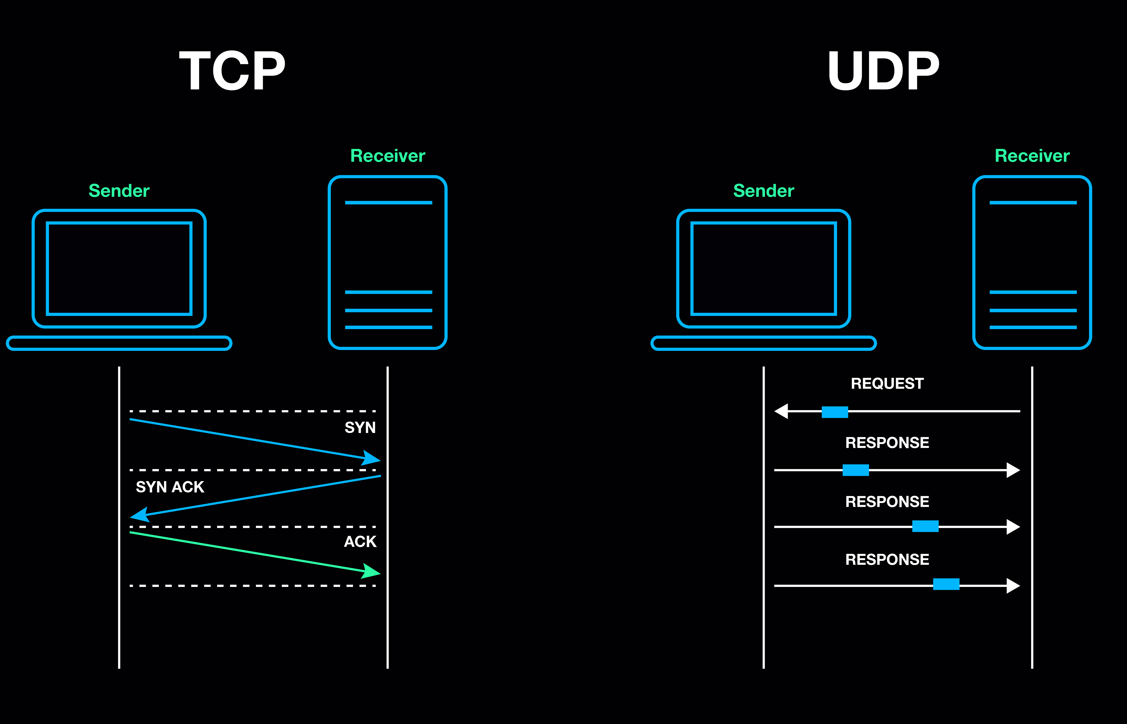
5
4 - Transport Layer
TCP - UDP
TCP (Transmission Control Protocol) Reliable, ordered, and error-checked communication.
Uses handshakes, acknowledgments, and retransmission.
Used for HTTP, MQTT, HTTPS, and most web traffic.
UDP (User Datagram Protocol) Fast, connectionless, and lightweight. No handshakes or retransmission — “send and forget.” Perfect for real-time data, broadcasting, and low-latency IoT.

Slide 6
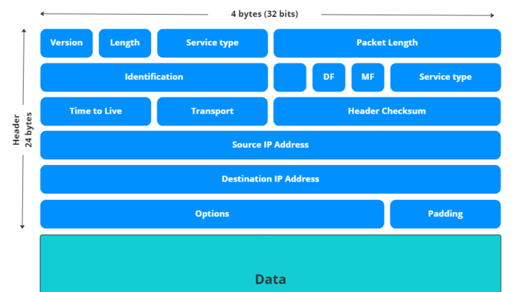
6
TCP/IP: The Foundation of Internet Communication
TCP/IP is the core communication model used by WiFi networks. TCP provides reliable, ordered data delivery with retransmission and acknowledgment, while IP handles addressing and routing between devices.
| Ethernet Header | IP Header | TCP Header | Data/Payload |
|--------------------------|--------------------------------|-------------------------------------|-------------------------|
| Src MAC, Dst MAC | Src IP, Dst IP, TTL, DSCP | Src Port, Dst Port, Seq, ACK | HTTP/MQTT/... |

Slide 7
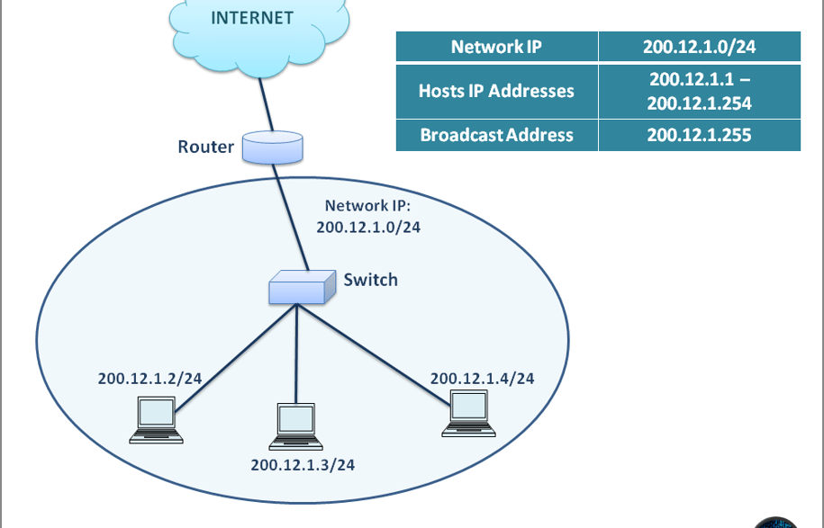
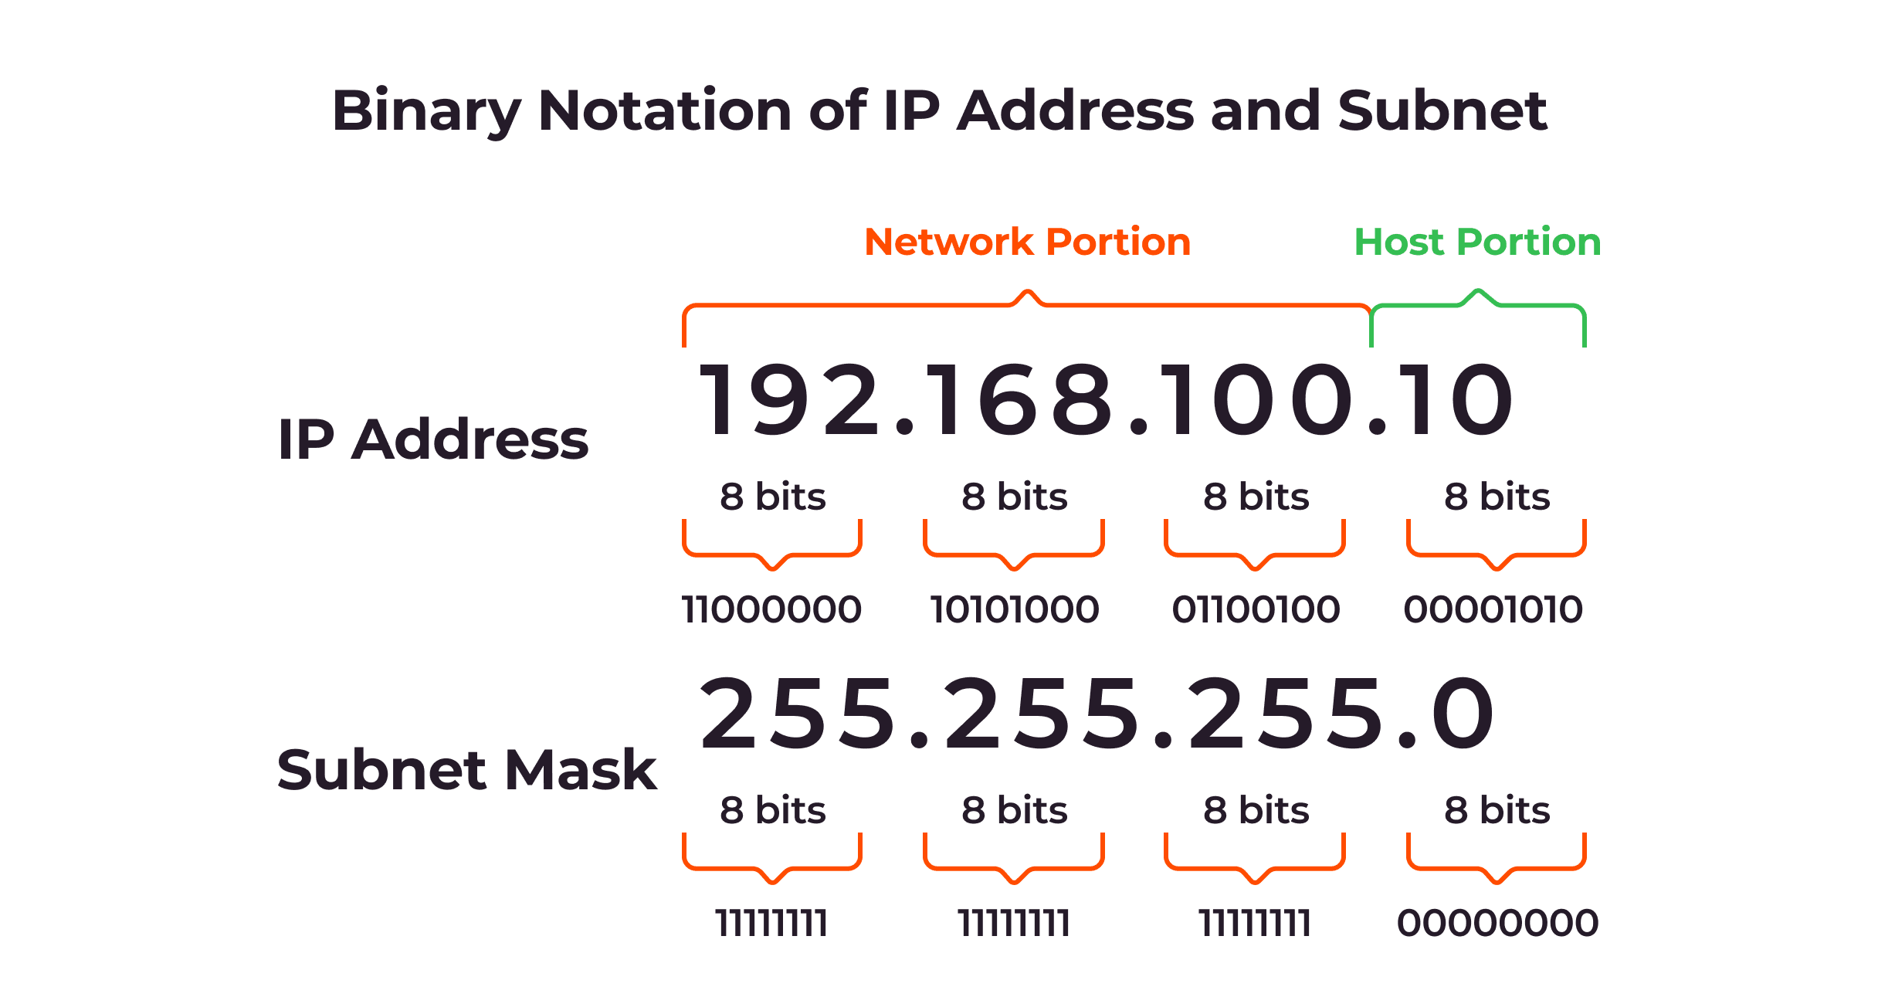
7
3 - IP Layer (Network Layer)
Responsible for addressing and routing packets across networks. Adds source and destination IP addresses to each packet. Determines the best path for data to reach its destination.
IP settings include IP address, subnet mask, and default gateway to define the device’s identity and network path.

Slide 8
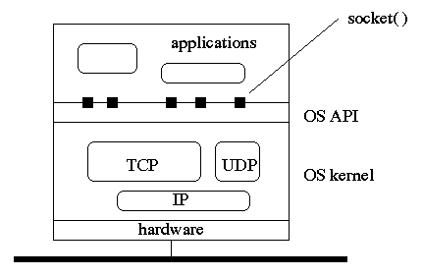
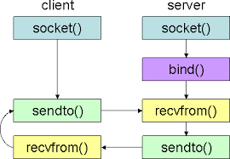
8
5 - Session Layer
Socket
A socket connects your application to the network. It maps your app’s port to the transport/IP layers. The OS handles headers, routing, and packet delivery. Your program just sends and receives data through the socket.

Slide 9
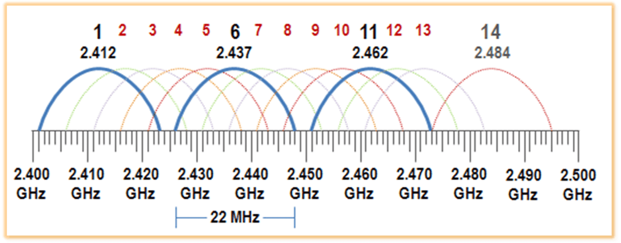
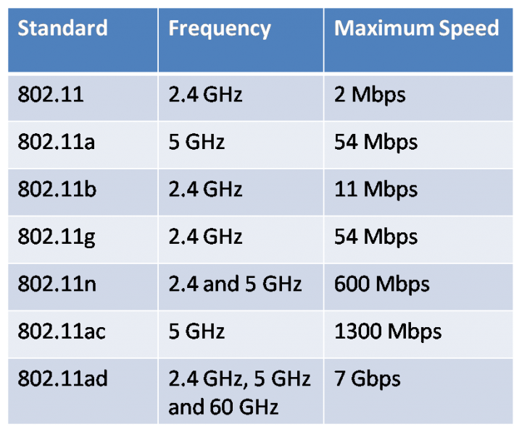
9
What is WiFi
Wi-Fi stands for Wireless Fidelity. It’s a marketing term (not a strict technical acronym) used to describe wireless local area network (WLAN) technology based on IEEE 802.11 standards.
Wi-Fi operates in the bottom two layers:
🔹 Layer 1—Physical Layer
Wi-Fi uses radio waves to transmit bits (0s and 1s).
Uses frequencies like 2.4 GHz and 5 GHz.
Handles modulation, signal strength, channels, antennas.
🔹 Layer 2—Data Link Layer
Wi-Fi follows the IEEE 802.11 standard.
Responsible for:
MAC addresses
Wi-Fi frames
Authentication & association
Managing retransmissions
Handling collisions & encryption (WPA2/WPA3)
Wi-Fi = 802.11 protocol at Layer 1 + Layer 2. IP, TCP, HTTP, etc. sit above Wi-Fi.

Slide 10
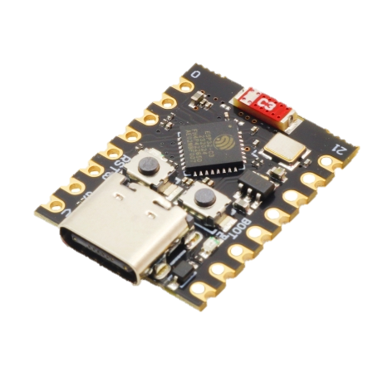
10
Wi-Fi Modes
Station Mode (STA)
Promiscuous Mode
Connects to an existing Wi-Fi network (like a phone or laptop joining a router).
Listens to all nearby Wi-Fi packets, not just ones addressed to itself (used for sniffing/monitoring).
Access Point Mode (AP)
Creates its own Wi-Fi network so other devices can connect to it.
ESP32-C3 Super Mini eca 247 T
Dual Mode (AP + STA)
Works as client and hotspot at the same time – connects to a router
and lets others connect to it.

Slide 11
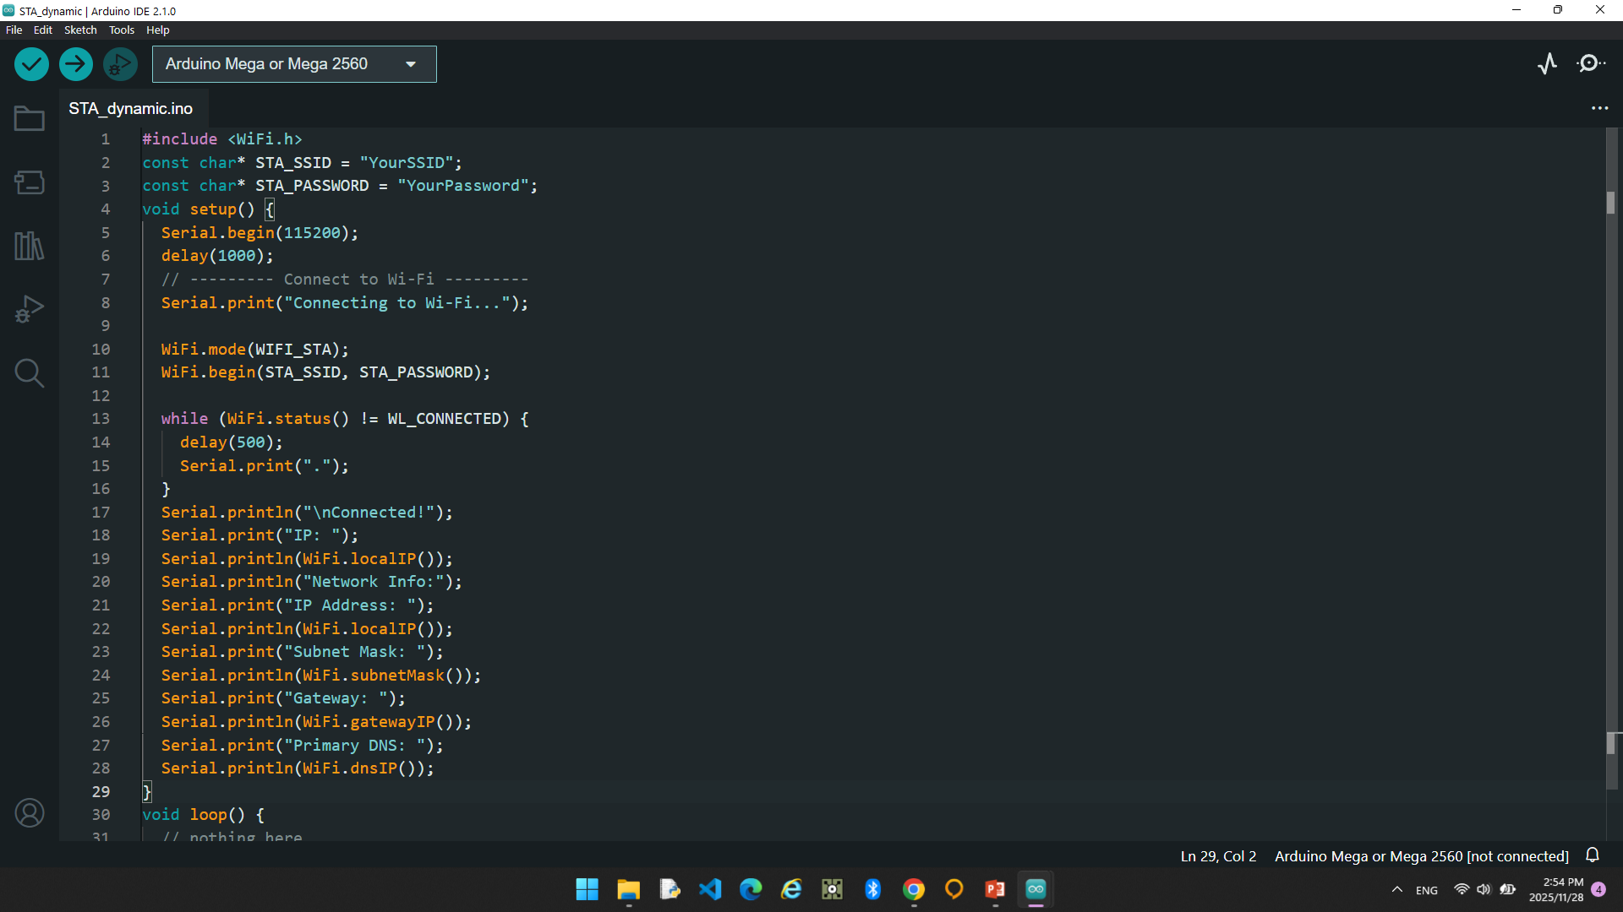
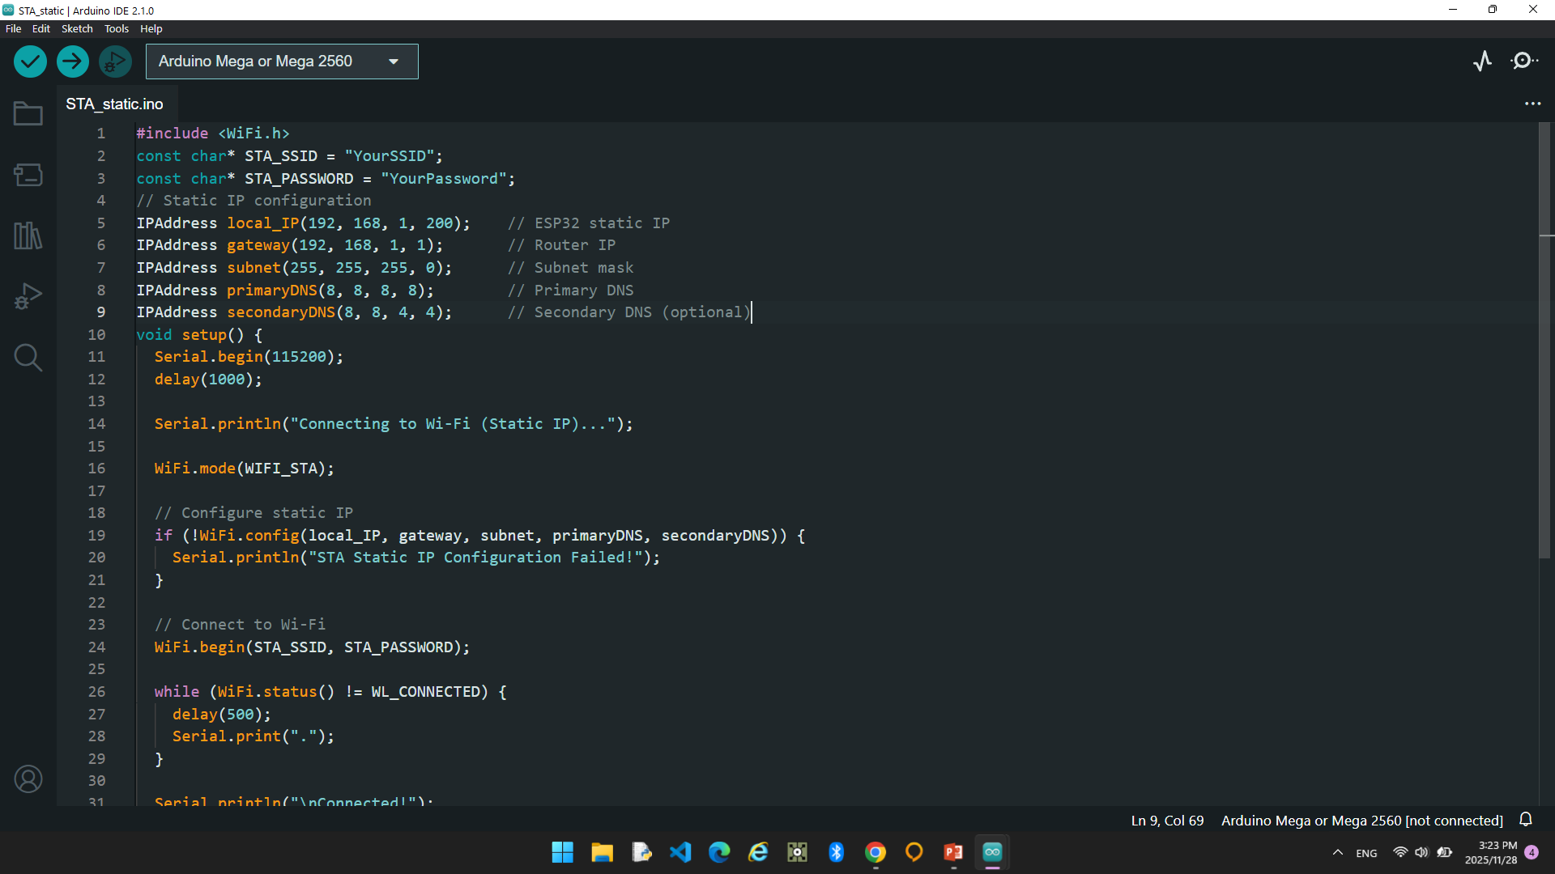
11
Wi-Fi Modes
Station Mode (STA)

Slide 12
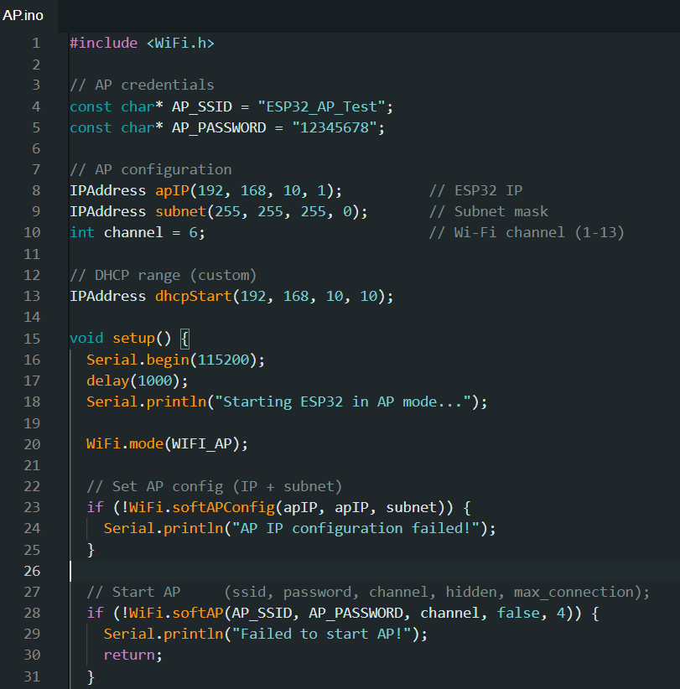
12
Wi-Fi Modes
Access Point Mode (AP)

Slide 13
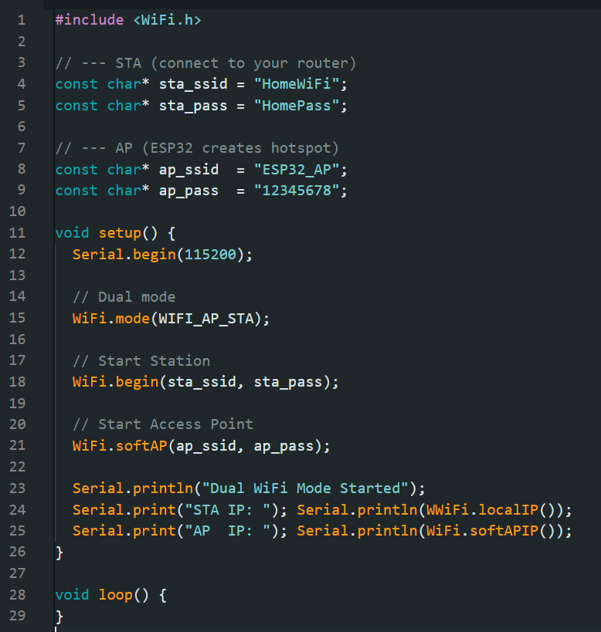
13
Wi-Fi Modes
Dual Mode (AP + STA)

Slide 14
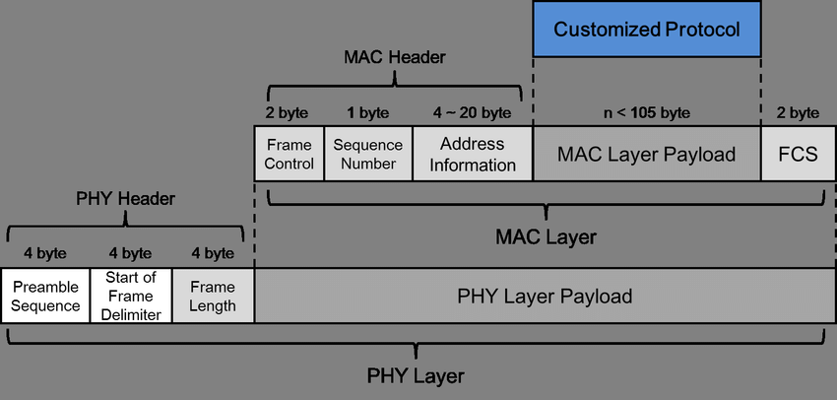
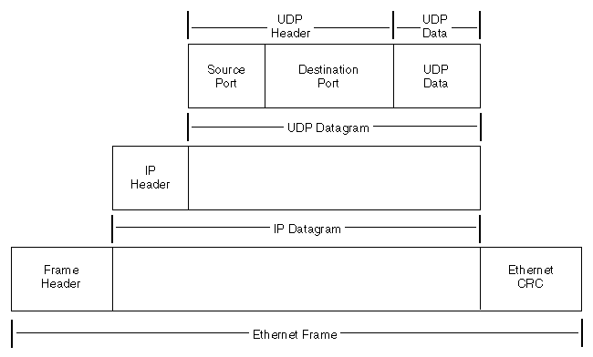
14
Wi-Fi Modes
Promiscuous Mode
captures Wi-Fi Layer 2 frames (MAC level), not higher-layer IP/TCP/HTTP data unless you manually decode payloads.

Slide 15
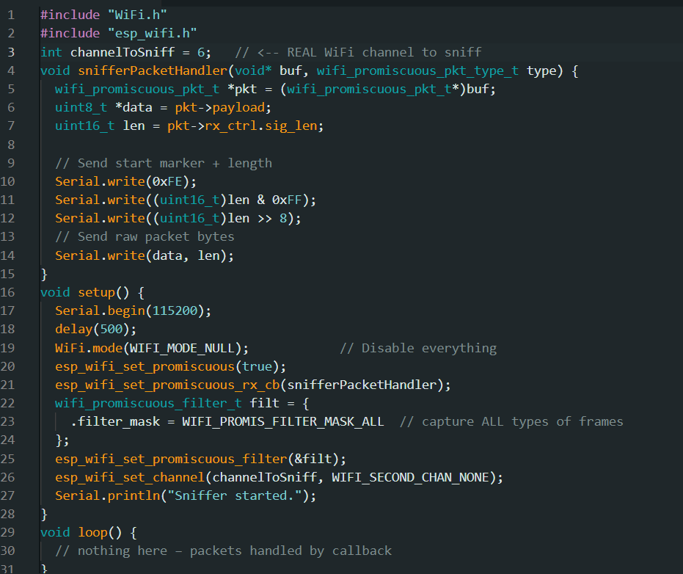
15
Wi-Fi Modes
Promiscuous Mode
treating captured HTTP data like a DNA-style byte sequence for pattern detection.

Slide 16
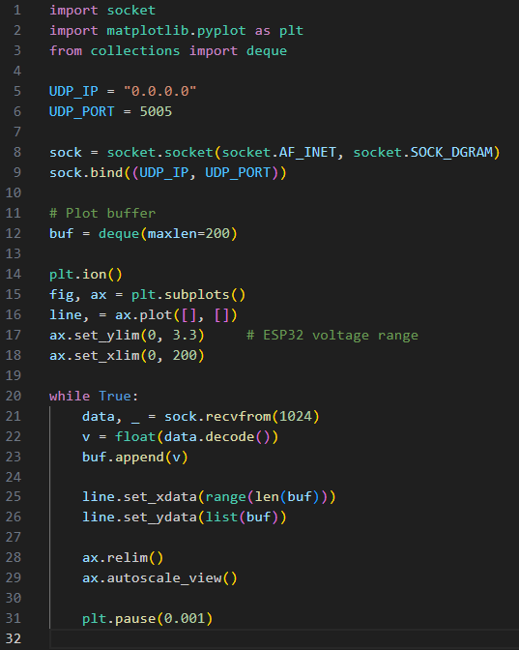
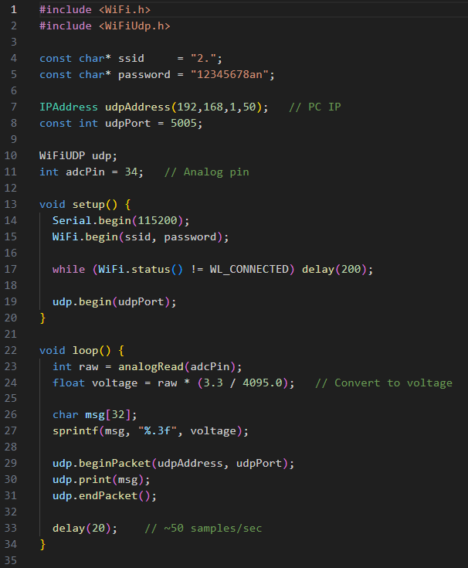
16
UDP from esp to python
Wireless Oscilloscope
ESP32 reads analog values and streams them over UDP Wi‑Fi. Python receives the data and plots it live as a simple wireless oscilloscope.

Slide 17
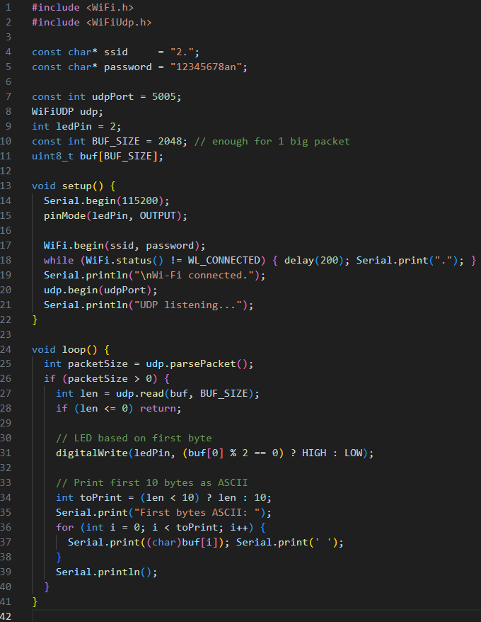
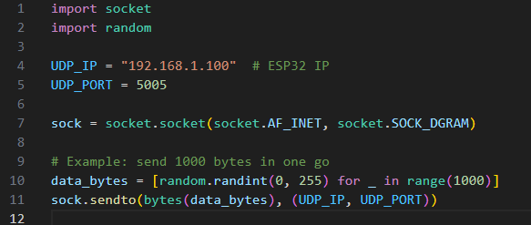
17
Receive UDP in ESP32
Reads all incoming bytes from Python,controls the built-in LED based on the first byte,and prints the first 10 bytes as ASCII for quick inspection.
MTU (Maximum Transmission Unit) sits at the Data Link layer and defines the largest frame payload. If an IP packet is bigger, Layer 2 fragments it for transmission over the network.

Slide 18
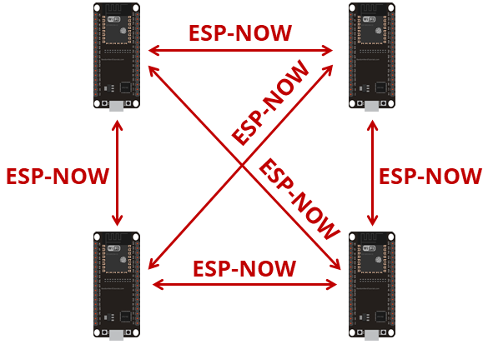
18
ESP-NOW
ESP-NOW operates at Layer 2 (Data Link / MAC layer) of the OSI model:
Uses the Wi‑Fi radio directly without a full TCP/IP stack.
Communicates via MAC addresses, not IP addresses.
Supports peer-to-peer or broadcast messaging with very low latency.
Ideal for sensor networks, IoT, and fast device-to-device communication.
ESP32 #1 reads analog values and broadcasts them via ESP-NOW.
ESP32 #2 receives the data and prints it to Serial for real-time plotting.

Slide 19
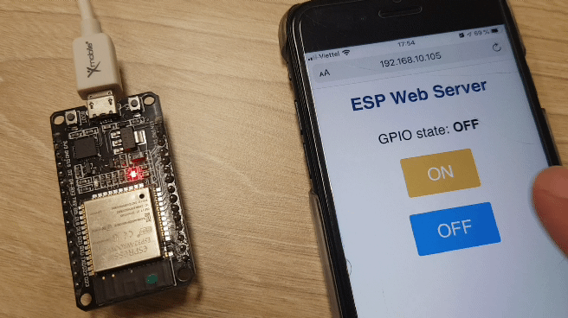
19
ESP32 Soft AP Web Server
Creates its own Wi-Fi network
Serves a simple HTML page
Button clicks are handled via HTTP requests (/on and /off)

Slide 20
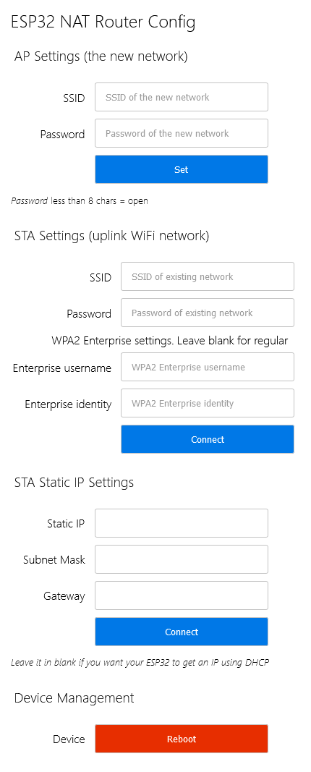
20
Cool Projects
ESP32 NAT Router with WPA2 Enterprise support
Simple range extender for an existing WiFi network
Mesh protocol built on Wi-Fi
nodes connect to each other, not all to the routerOne root node connects to the normal Wi-Fi router and bridges to the internetOther nodes form a tree (parent/child) and relay packets (multi-hop) to extend rangeWith IP enabled, all nodes can use normal TCP/UDP
painless Mesh
Runs on ESP8266 & ESP32 using Arduino
Self-forming, self-healing mesh (nodes auto-join and re-route)
No master – all nodes are equal and can reach each other via multi-hop
Supports broadcast and single-node messages
Messages sent as easy-to-use JSON strings
Built-in time synchronization across all nodes
Mesh topology auto-updates, so nodes know the network layout
Asynchronous callbacks for received messages (no blocking loops)

Slide 21
ESP32 Technical Reference Manual
TNX

